Slide 1
Python Programming
Prepared by
Ravikumar R(Ravikumarr@gmail.com)

Slide 2
Introduction to Python
Why Python works so well as your first programming language
Three types of Python applications
The source code for a console application
How Python compiles and runs source code
How to use IDLE to develop programs
How to use the interactive shell
How to work with source files
How to compile and run a program
How to fix syntax and runtime errors

Slide 3
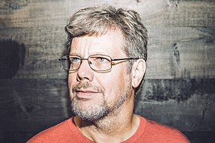
History of Python
Python programming language was developed in 1990s by Guido van Rossum of the Netherlands
It was intended to be simple, intuitive language that is as powerful as traditional languages, and it succeeded at that.
Guido named the language Python because he was a big fan of “Monty Python’s Flying Circus”
He continues to be involved in the development of Python and making decisions when necessary.
It’s open source
Picture Credit - https://en.wikipedia.org/wiki/Guido_van_Rossum

Slide 4
Why Python is a great first language
It’s much closer to plain English
Syntax of Python is much simpler compared to other programming languages
Able to write with far less code when compared to Java, C# or C++

Slide 5
Why Python
Beginner Friendly
Easy to understand with lesser lines of code
Easy to Prototype and Test : Lesser Delivery Time
Cross Platform
Free, Open Source and Community Development
Easy to integrate with other languages C, C++, JAVA …
Vast set of libraries available for Web, Machine Learning, Data Mining…
Presence of Third Party Modules
User-friendly Data Structures

Slide 6
The Python timeline
Year | Month | Release | Description
2000 | October | 2.0 | First release of Python 2
2008 | December | 3.0 | A redesign of Python that isn’t backward compatible
2010 | July | 2.7 | Last release of Python 2 with support until 2020
2018 | March | 3.6.5 | The latest stable release at this writing (26th May 2018)
Python 3 isn’t backward compatible. That means that Python 3 can’t run most programs written for Python 2.
Conversely, Python 2 isn’t forward compatible. That means that it can’t run most programs written for Python 3.

Slide 7
Three types of Python applications
A console application is a desktop application that uses the console to interact with the user.
A GUI application is an application that uses a graphical user interface (GUI) to interact with the user.
A web application typically gets request from a web browser, processes them on a web server, and returns the responses to the web browser.

Slide 8
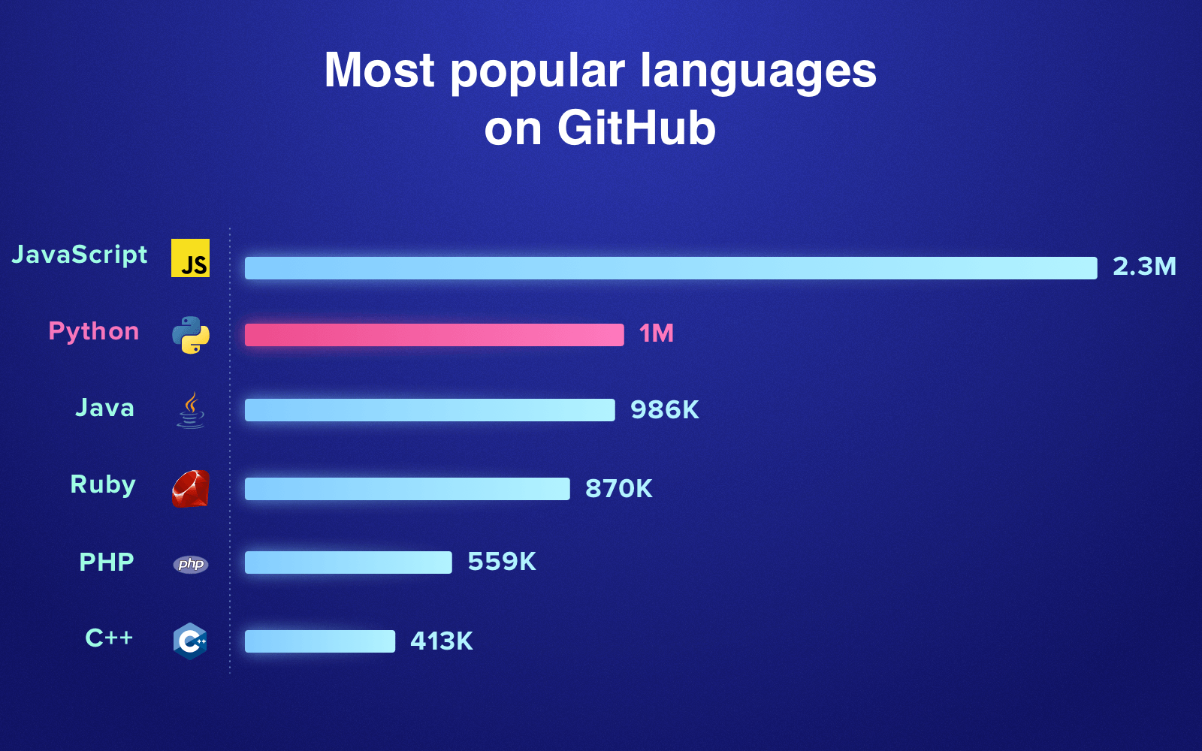
Python’s popularity
It's the 2nd most popular language on GitHub

Slide 9
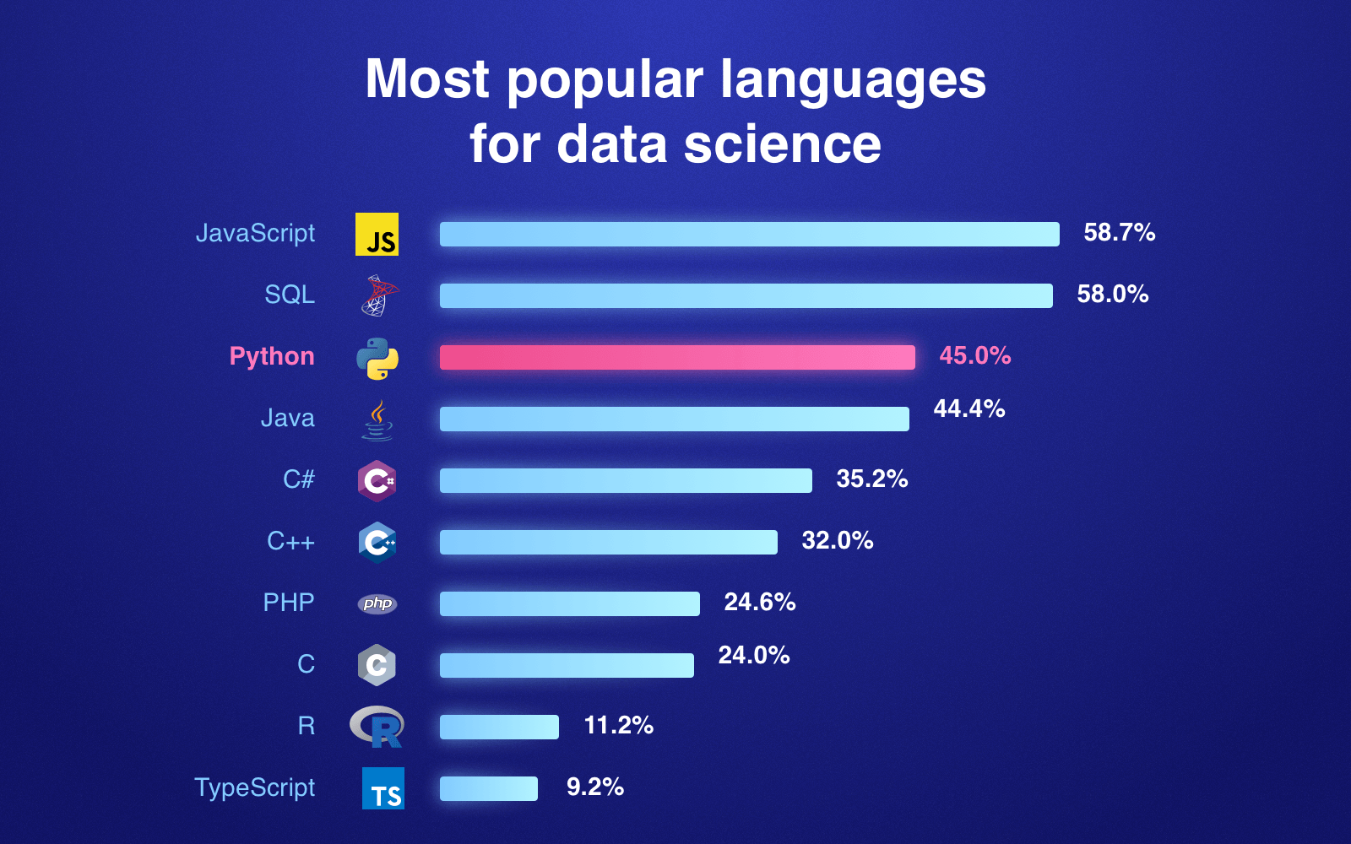
What is Python good for
It's a popular language for data science (Source: Stack Overflow)

Slide 10
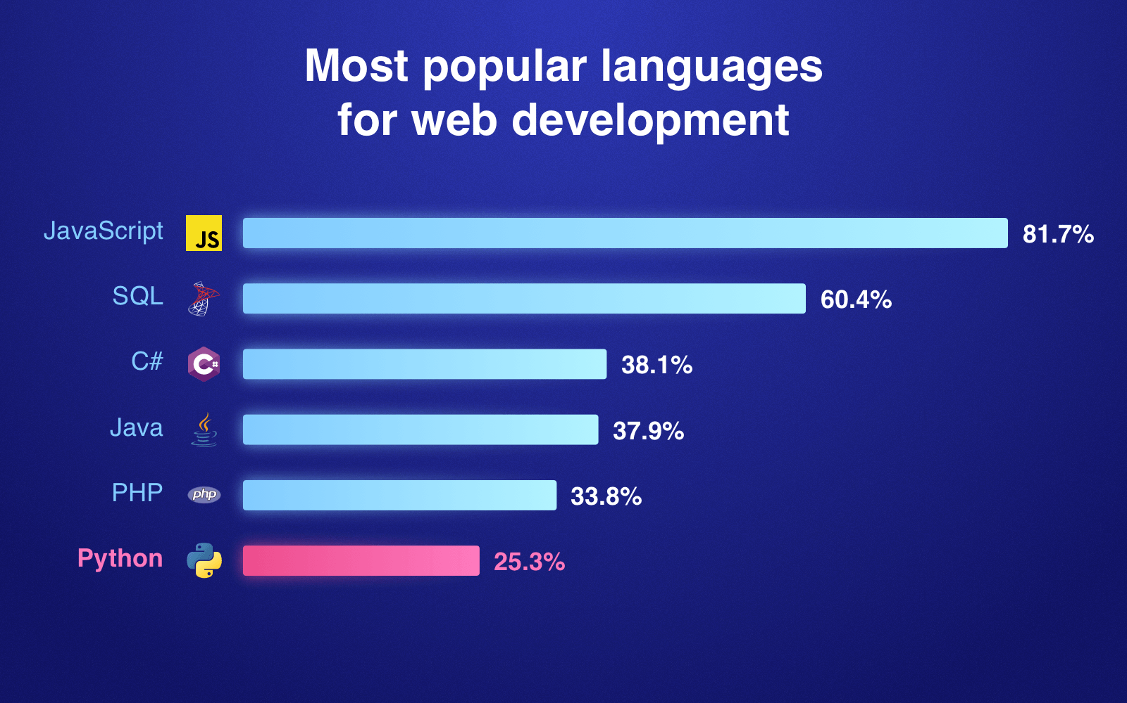
What is Python good for (Continued…)
Uses of Python programming language for web development (Source: Stack Overflow)

Slide 11
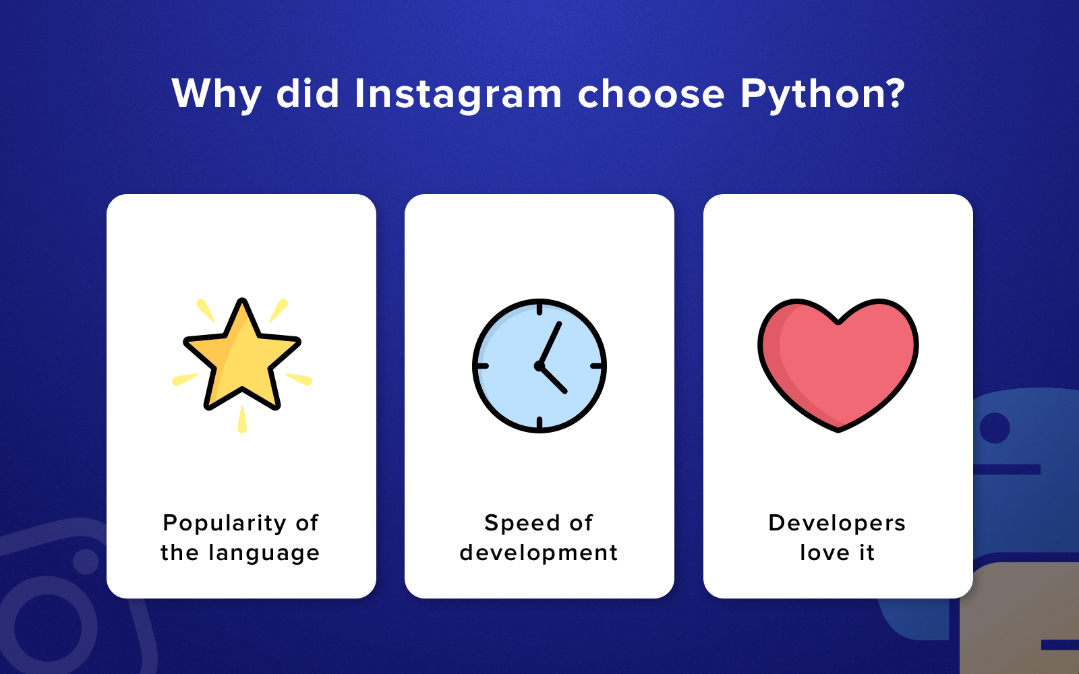
Companies that use Python Instagram
The company has recently moved to Python 3 and Instagram is just great example of a gigantic tech company using Python language in combination with Django (Python's framework).

Slide 12
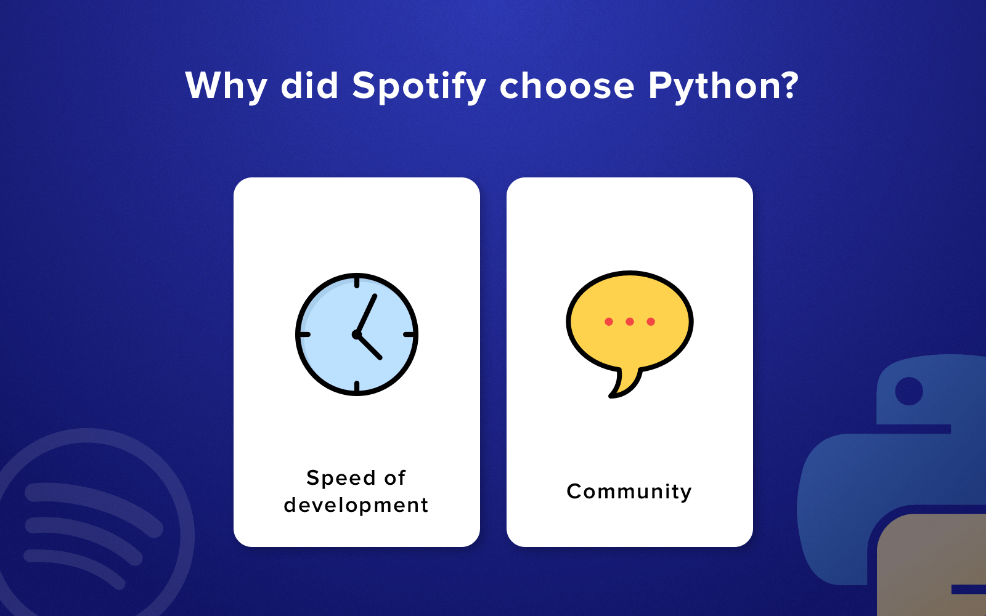
Companies that use Python Spotify
Spotify also trusts Python and applies it in its back-end services, as well as for data analysis purposes.

Slide 13
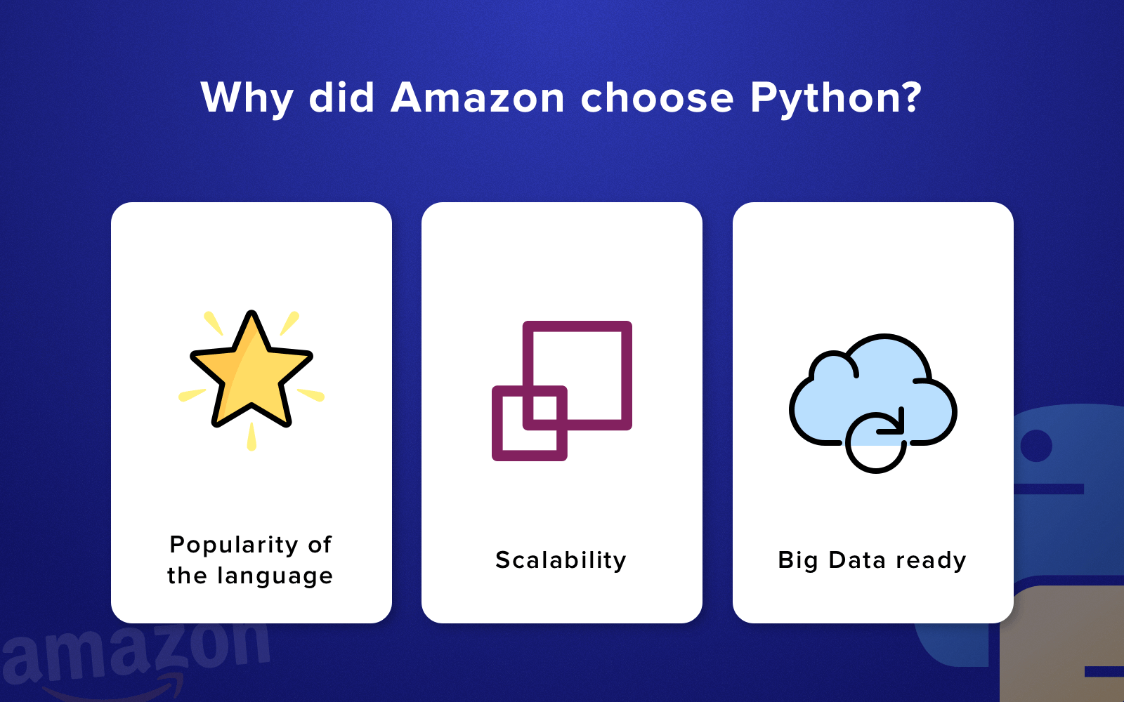
Companies that use Python Amazon
To provide its customers with accurate recommendations, Amazon analyzes their buying habits and search patterns. That's possible due to their Python machine learning engine which interacts with company's database Hadoop. So, they combine and work together in order to achieve the most efficiency and accuracy in giving recommendations.

Slide 14
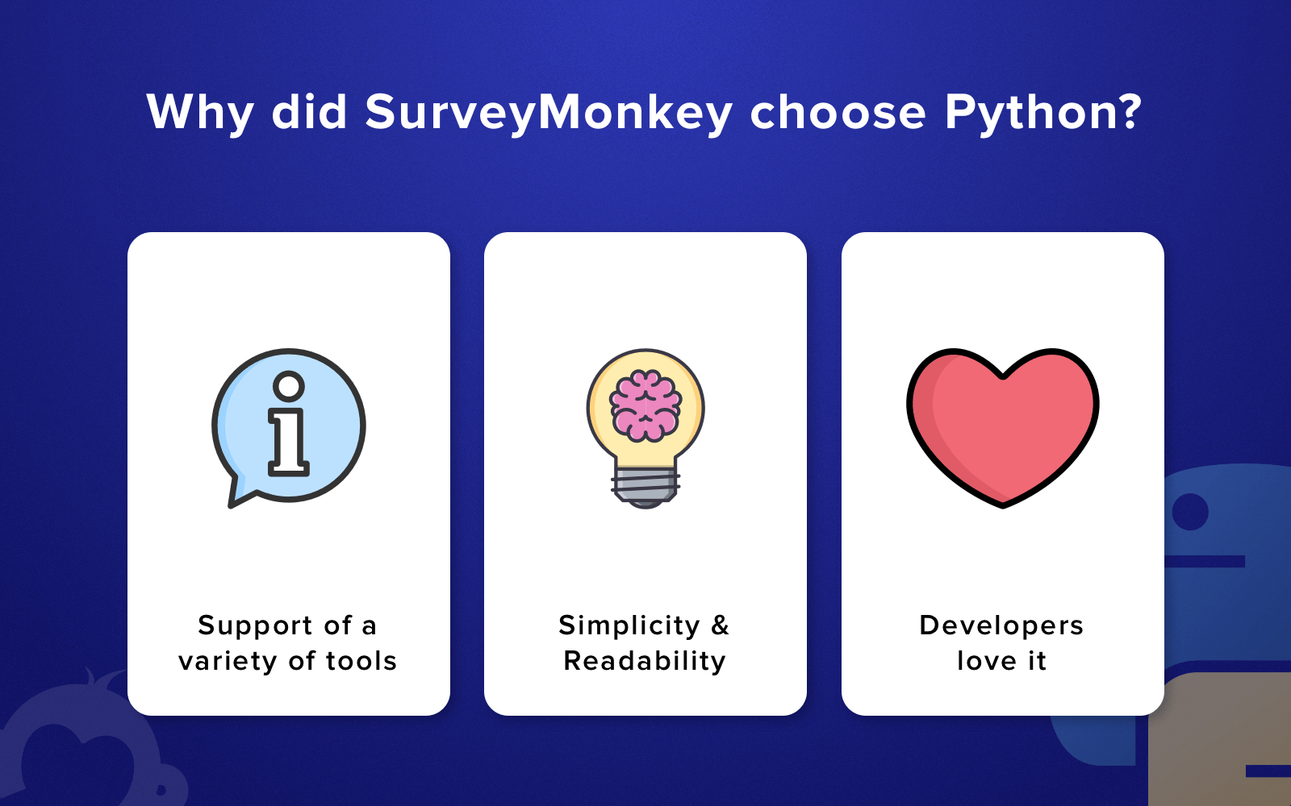
Companies that use Python SurveyMonkey
It's one of the largest survey companies in the world that processes more than 1 million survey responses daily. At the very beginning, the company's web app was monolithic and built on .NET along with C#. In general, there weren't any issues with the smoothness of the system, but it was relatively slow in testing and deployment of new features.

Slide 15
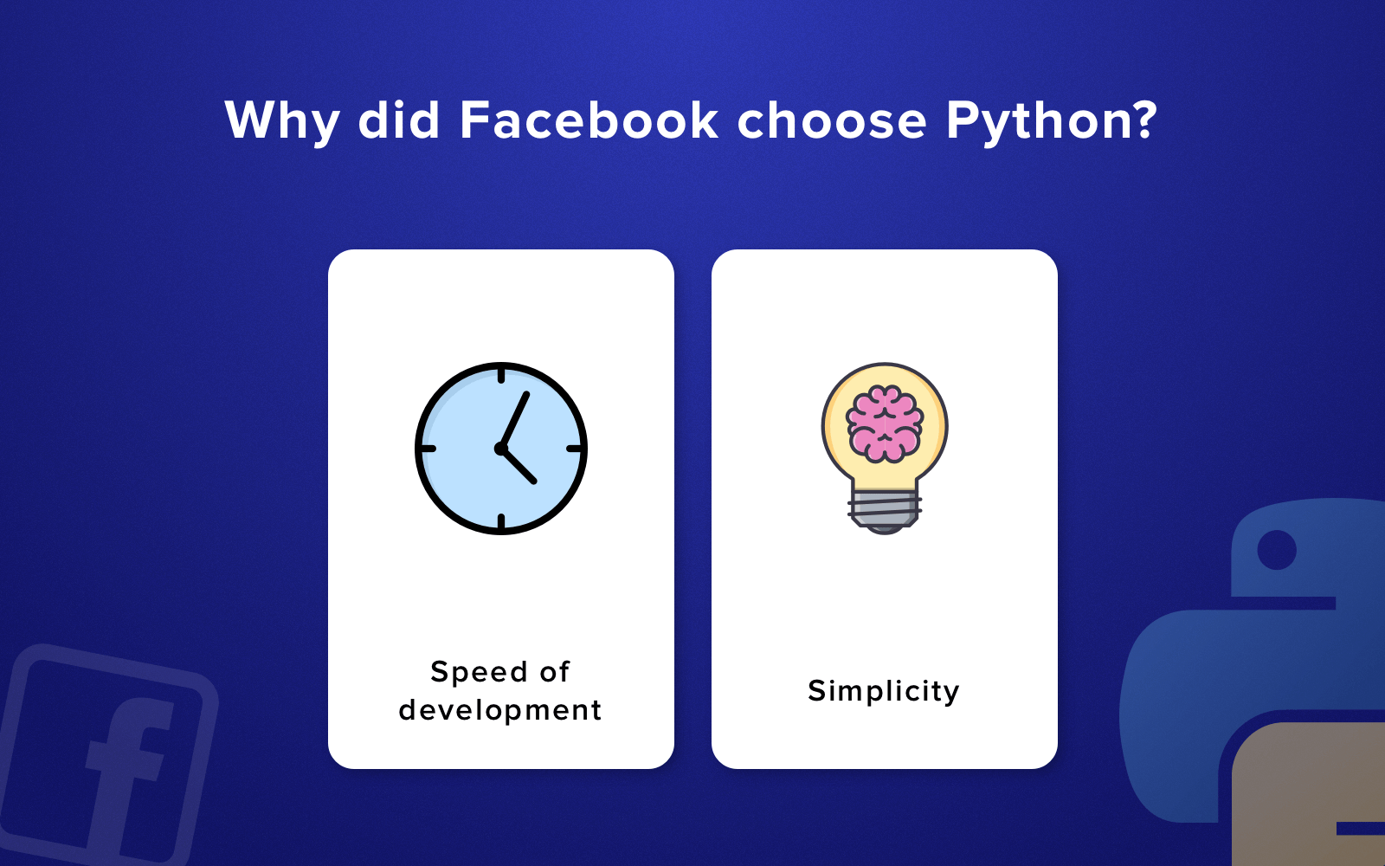
Companies that use Python Facebook
Facebook applies Python largely to process images. It's quite obvious that this social network deals with huge amount of data including tons of images. The company decided to use Python as the core language for the back-end of their applications connected with image processing (e.g. image resizing).

Slide 16
Other top tier companies that uses Python
Google
Quora
Netflix
Dropbox
Reddit
Yahoo
NASA
IBM
Mozilla

Slide 17
Applications of Python
Testing and Automation
Numerical Computing
Machine Learning and Image Processing for Prototyping and Application
Development
Data Science
Web and Internet Development

Slide 18
Downloading Python
Python available at the official website
https://www.python.org/downloads/
Python is available for different operating systems
Windows
Linux/Unix
Mac
Other
*Current stable version is 3.6.5 as of this writing (26th May 2018)

Slide 19
Installing Python
Windows
Download the executable and run it
Linux (Ubuntu)
Run the command on Ubuntu shell
sudo apt-get install python3

Slide 20
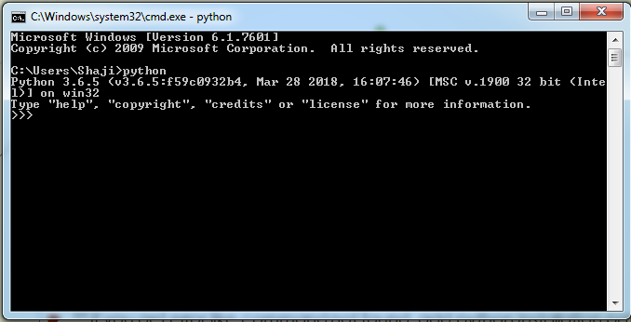
Testing Installation : The Interactive shell
Windows :
Press Windows Key and type cmd.
On the Terminal type python
Linux :
Open a terminal
(Ubuntu CTRL+ALT+T) and type python
** if you get error like command not found, add python installation path

Slide 21
Free tools for working environment
Use an IDE
Pycharm Community IDE (Lightweight IDE for Python & Scientific development)
https://www.jetbrains.com/pycharm/download/
Eclipse with PyDev
https://marketplace.eclipse.org/content/pydev-python-ide-eclipse
Thonny Python IDE for beginners
http://thonny.org/
Visual Studio Code
https://code.visualstudio.com/
Anaconda
https://www.anaconda.com/download/
Use any text editor and Command line
Notepad++, vi, vim, gEdit, jEdit

Slide 22
Python Documentation
Python documentation
https://docs.python.org/3/
Python standard library
https://docs.python.org/3/library/index.html
Python HOWTOs
https://docs.python.org/3/howto/index.html
Python Frequently Asked Questions (FAQs with answers)
https://docs.python.org/3/faq/index.html
Python tutorial
https://docs.python.org/3/tutorial/index.html

Slide 23
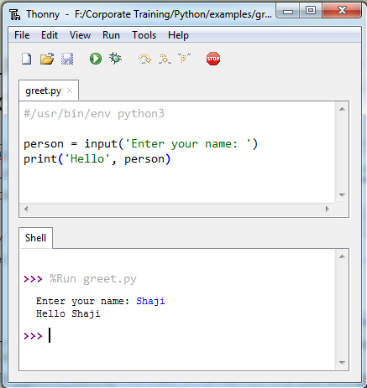
The source code for a console application
#/usr/bin/env python3
person = input('Enter your name: ')
print('Hello', person)
>>> %Run test.py
Enter your name: Shaji
Hello Shaji
Discussion
The first line in this program is called the shebang line, or shebang. It specifies the interpreter that should be used to run the program.
This application gets a value (in this case a name) from the user and greet that person saying “Hello <Person Name>”

Slide 24
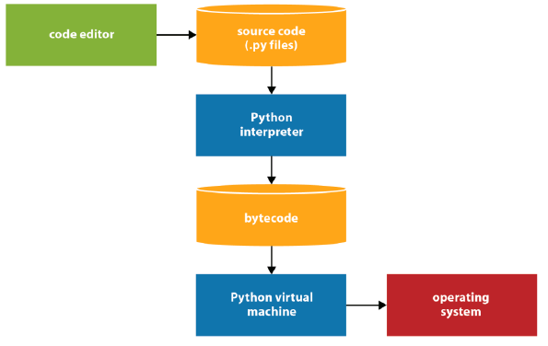
How Python compiles and runs source code
Step 1 : The programmer uses an IDE or text editor to enter the source code
Step 2 : The source code is compiled by the Python interpreter into bytecode.
Step 3 : The bytecode is translated by the Python virtual machine into instructions that can interact with the operating system of the computer

Slide 25
What do the python file extensions, .py, .pyc .pyd .pyo stand for?
.py: This is normally the input source code that you've written.
.pyc: This is the compiled bytecode. If you import a module, python will build a *.pyc file that contains the bytecode to make importing it again later easier (and faster).
.pyo: This is a *.pyc file that was created while optimizations (-O) was on.
.pyd: This is basically a windows dll file. http://docs.python.org/faq/windows.html#is-a-pyd-file-the-same-as-a-dll

Slide 26
How to compile and run a program
From the editor window, press the F5 key or select Run -> Run Module.
If IDLE displays a dialog box that indicates that you must save the program first, click OK to save it. Then, if the program doesn’t have any errors, IDLE runs the program in the interactive shell.
Description
If Python doesn’t detect any errors, it runs the program.
If Python detects any errors, it usually alerts you and it doesn’t run the program.
When you use IDLE to run a console application, it uses the shell as the console.
On most platforms, IDLE’s shell automatically becomes active when you run a console application. If it doesn’t, you have to switch to the shell after you run the application.

Slide 27
How to fix syntax and runtime errors
After you write the code, you test the program to make sure it works. As a part of that process, you will usually find errors(bugs) and you have to debug the program
A syntax error violates on of the rules of Python coding so the source can’t be compiled.
In contrast, a runtime error occurs when a Python statement can’t be executed as the program is running.
When all the errors have been fixed, the program will run. But here again, only one runtime error is detected at a time. So you have to fix the error, run the program again, and keep doing until all the runtime errors have been debugged.
A runtime error is also known as an exception.
The goal of testing is to find all of the errors in a program. The goal of debugging is to fix all the errors.

Slide 28
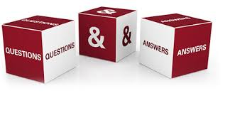

Slide 29


